Slide 1
Barriers to implementing a just culture
Austin Moore
CSD380 – DevOps
09/28/2024

Slide 2
What is just culture
Definition: A just culture balances accountability with learning by addressing errors without blame but through behavior accountability.
Core Values:
Encourages transparency
Focused on system wide improvements
Promotes Safety

Slide 3
Legal Barriers
There is a complexity when it comes to legal systems around ‘just cultures’. In many areas, legal frameworks around workplace safety create conflict. The ‘just culture’ reassures that there isn’t blame on the individual, but rather the process. However, there is still a line where honest mistakes could still face criminal charges if it’s deemed negligent. This can create grey areas and prevent transparency between employees and managers.

Slide 4
Technological barriers
Modern technology can cause major failures which could be done beyond control of individuals, but individuals can still be blamed. Sometimes organizations struggle to balance accountability between individuals and complexities of technology.

Slide 5
Societal & psychological barriers
When there are complex systems that have issues, failure points can be directed to individuals to blame versus the system itself which can create a “blame game” environment. Furthermore, this can create underlying issues where employees won’t report errors because of the worries around being blamed. Also, it can create a morale issue because employees could feel undermined if they are being targeted or blamed for system errors, or even errors they did create themselves on accident.

Slide 6
Organizational Barriers
There are some cultures out there that have negative and deeply ingrained blame cultures that can prove to be extremely challenging. Reversing this culture can take lots of time and lots of adjustments in the team, to which creates more issues because lots of people don’t like change. Leaders can also lack the skills or training to understand what a ‘just culture’ should look like, how it works, and the principles are behind it. Not having a strong leadership team supporting the ‘just culture’ can be the start of long journey to success.

Slide 7

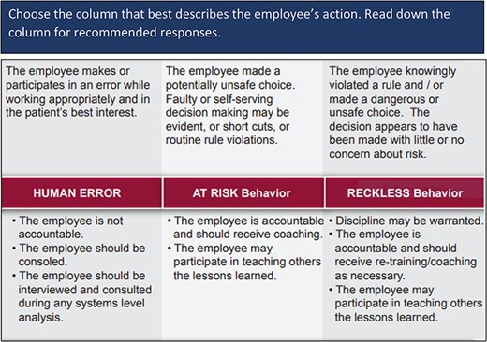
Veterans health administration example
This is a Just Culture Decision support tool that the Veterans Health Administration uses when trying to balance system and individual accountability.

Slide 8
Sources
Kim, G., Humble, J., Debois, P., Willis, J., & Forsgren, N. (2021). The devops handbook: How to create world-class agility, reliability, & security in technology organizations (Second ed.). IT Revolution Press.
Murray, J. (2022, May 18). Implementing just culture to improve patient safety. OUP Academic. Retrieved September 28, 2024, from https://academic.oup.com/milmed/article/188/7-8/1596/6589441?login=false
Shorrock, S. (2023, October 18). Why is it just so difficult? barriers to 'just culture' in the real world. Humanistic Systems. Retrieved September 28, 2024, from https://humanisticsystems.com/2023/10/18/why-is-it-just-so-difficult-barriers-to-just-culture-in-the-real-world/

